Slide 1
Flatiron school module 2 project
Multi-variate Linear Regression on King County, WA
House Sales Dataset
Christian Lopez
Notes:
- I will be presenting a multi-variate linear regression on the King County, Washington House Sales Dataset

Slide 2
Problem statement:
How can we maximize profit?
Search of actionable insights
Understanding of house market
Notes:
How can we make sure to maximize profitability when attempting to sell a home in King County
Search for actionable insights that will serve to guide sellers
An understanding of the dynamics of the housing market will drive calculated decisions

Slide 3
Business value:
Price estimation
Feature selection and impact
Latest house price trends
Notes:
- Price estimation will shed light on what our decision-making process should look like and what we should be paying particular attention to
- We will examine the features we should be considering when selling a home, as well as measure to what degree they impact the price of the home
- We will survey the trends in house prices dependent upon different features

Slide 4
Methodology: osemn
Obtain
Scrub
Explore
Model
interpret
Notes:
The methodology used is known as OSEMN
This is a pipeline of crucial steps to follow when conducting any type of data science project
It consists of obtaining the data, scrubbing/cleaning the data, exploring/visualizing the data which will allow us to find patterns and trends, modeling our data in order to form predictions, and interpreting our data in the form of results

Slide 5
Methodology: STEP-BY-STEP
Obtain data and read it in using the Pandas package
Scrub data using the Pandas and NumPy packages
Explore data using Matplotlib and Seaborn
Model data using linear regression modules from Scikit-Learn
Interpret results
Notes:
We first obtained the data, and read it in using the Pandas package
Cleaning of the data was done using Pandas and NumPy
We conducted some data exploration using Matplotlib and Seaborn
After that, we modeled our data in the form of linear regression models using Scikit-Learn
And, lastly, we derived and interpreted our results

Slide 6
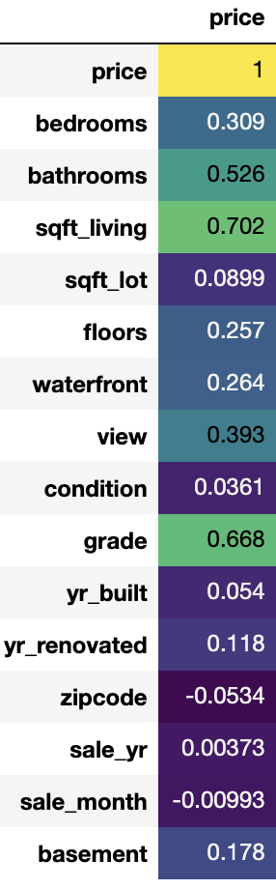
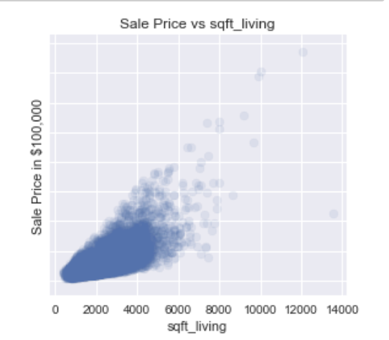
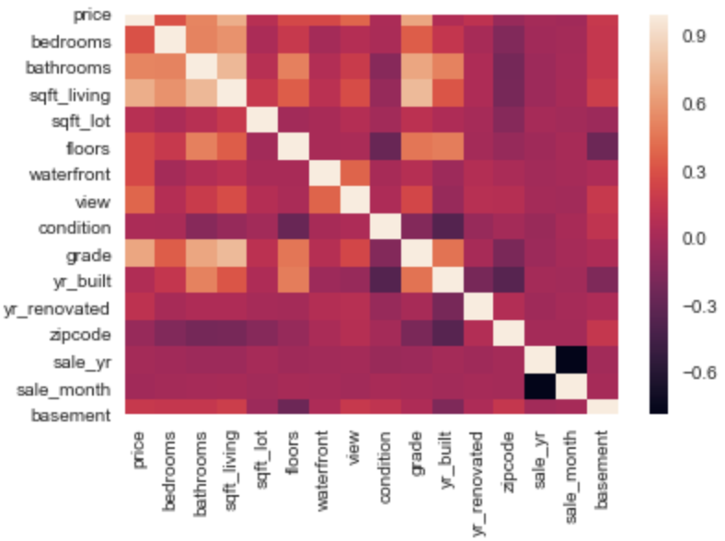
Recommendation #1 living space (sqft)
Living space square footage is the single most important feature
Larger homes mandate a higher asking price
Attempt to sell homes with a great deal of square footage
Notes:
- My first recommendation to seller would be to make living space square footage their focal point
- There is a high correlation of .702 between square footage of living space and the price of the home. This is higher than any other feature that we looked at.
It is evident that larger homes mandate a higher asking price. This can be seen by looking at the scatter plot on the top left. There is clearly a positive correlation with an upward trend. As square footage increases, so does the price.
It would be wise to focus on selling homes that are on the larger-end of the spectrum. This would undoubtably increase the potential commission that the seller will accrue.

Slide 7
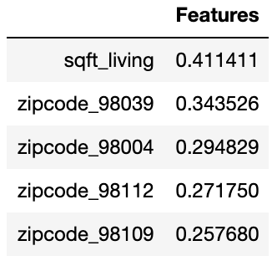
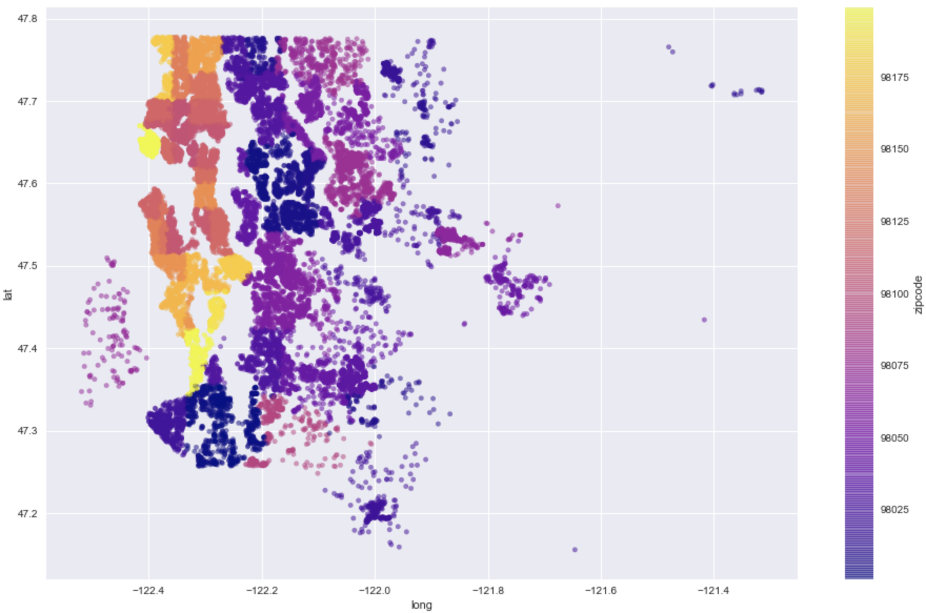
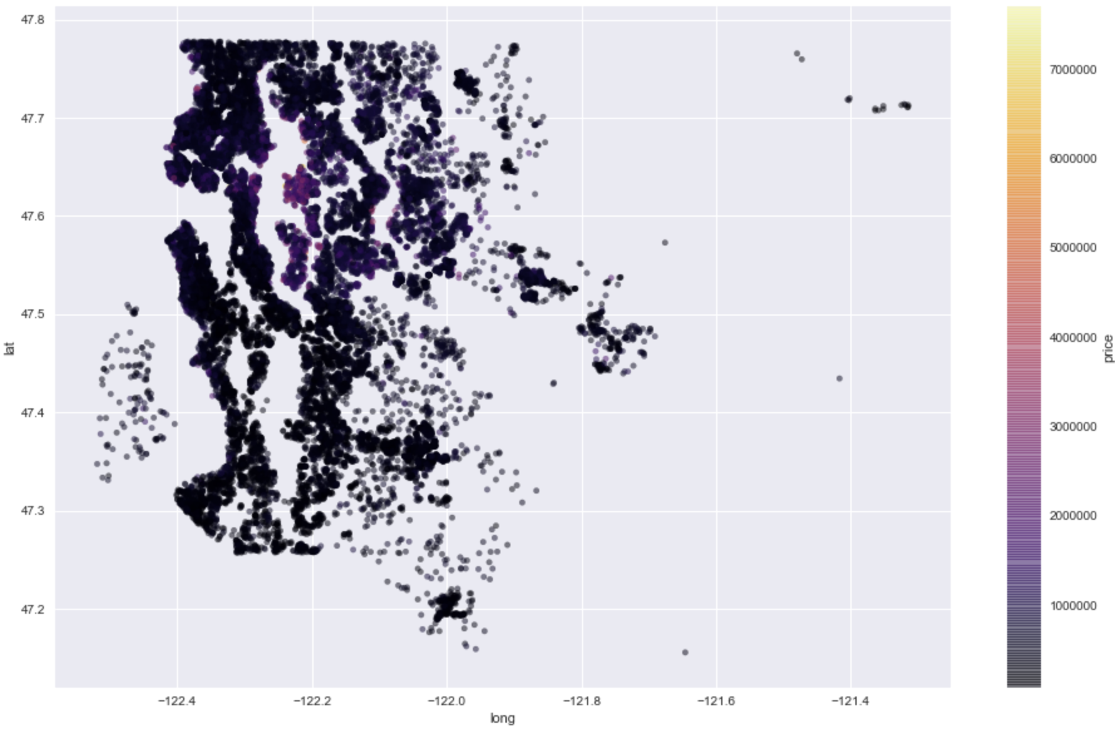
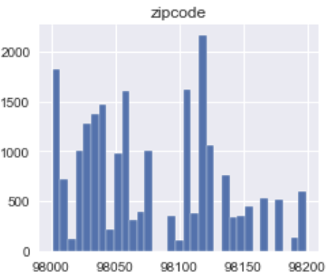
RECOMMENDATION #2: ZIPCODE (LOCATION)
Location of homes is very important
House prices seem to be clustered in terms of zipcode
Certain zipcodes can encompass many factors and variables
Notes:
My second recommendation would be to pay particular attention to the locality of the home
House prices seem to be clustered depending on the zipcodes, which means certain zipcodes may have higher price margins than do others
We must also bear in mind that there are many factors and variables that may make one zipcode more exclusive than the other. This may be due to components such as being in close proximity to a reputable school, fancy shopping center, or upscale restaurant.

Slide 8
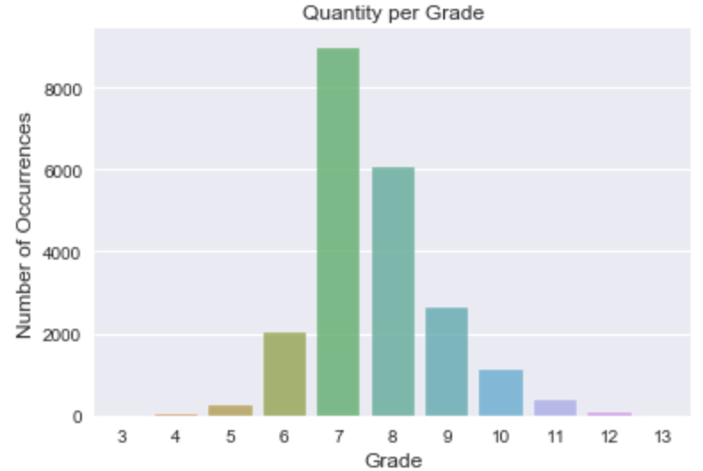
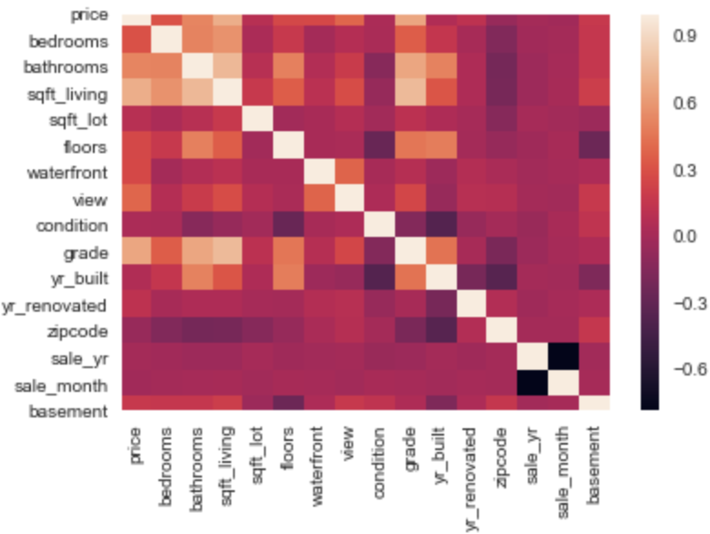
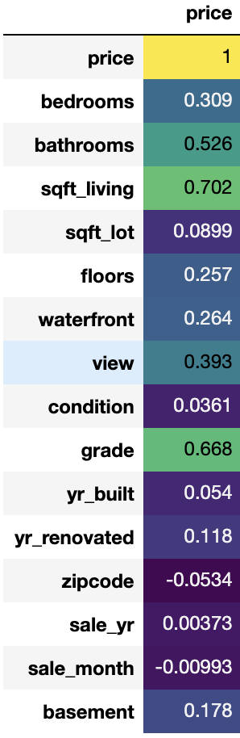
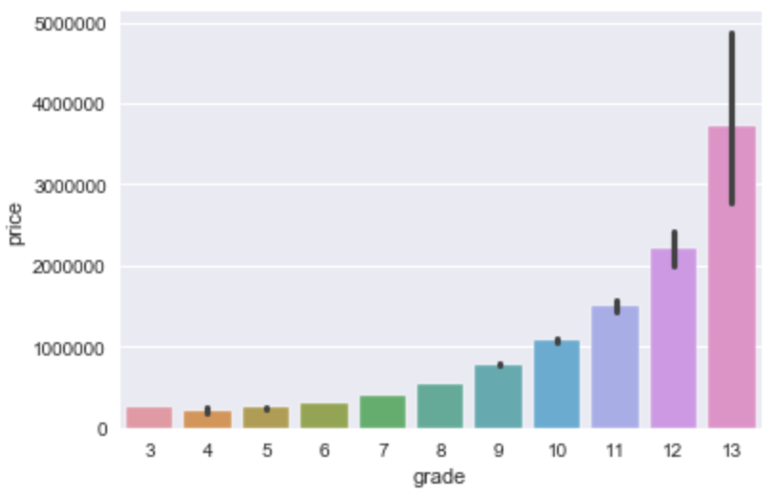
Recommendation #3: grade
King County, WA grading system very influential
The higher the grade, the higher the price that the house commands
The grading distribution appears to follow a normal curve
Notes:
My third recommendation would consist of attending to the grade
The grade given by King County seems to be very influential after looking at the correlation visualizations
In general, as the grade increases, the price increases as well
Also, the grades seem to follow a normal curve. This suggests that there is nothing weird going on with how the grades are being distributed, and they propose a fair representation.

Slide 9
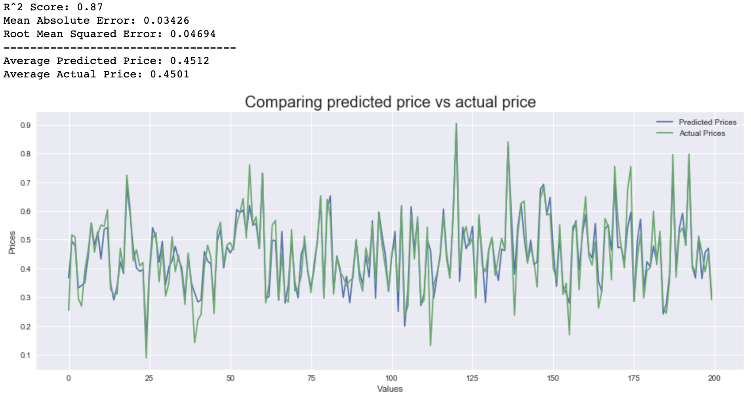
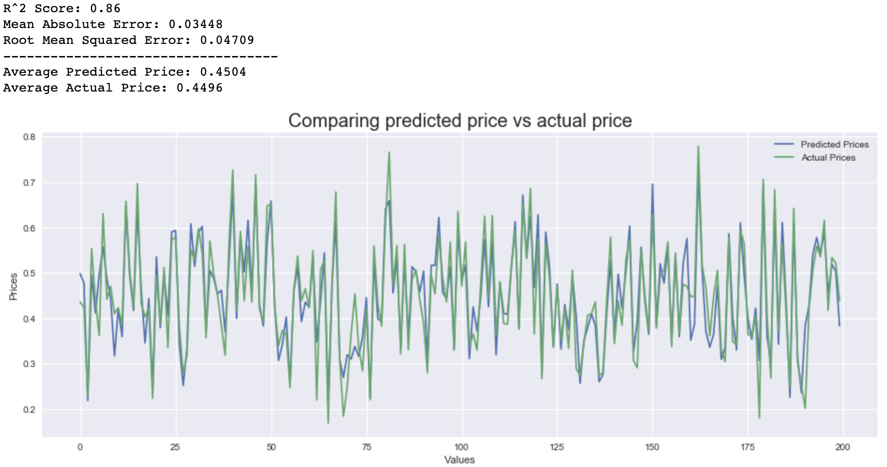
Final multi-variate linear regression model:
(top)
multi-variate linear regression model accounting for sqft_living, zipcode, and grade w/o significant features
(bottom)
multi-variate linear regression model accounting for sqft_living, zipcode, and grade w/ significant features
Notes:
After performing our initial multi-variate linear regression, I arrived the conclusion to use sqft_living, zipcode, and grade as our features in our final multi-variate linear regression
I went ahead and conducted two final multi-variate linear regression models using those features
The top figure shows the regression model w/o significant features. The model accuracy was 87%
The bottom figure shows the regression model after applying the significant features with p-value < 0.05. The model accuracy decreased from 87% to 86%.
Although, the model dropped by 1%, it is still able to predict house prices with great accuracy.

Slide 10
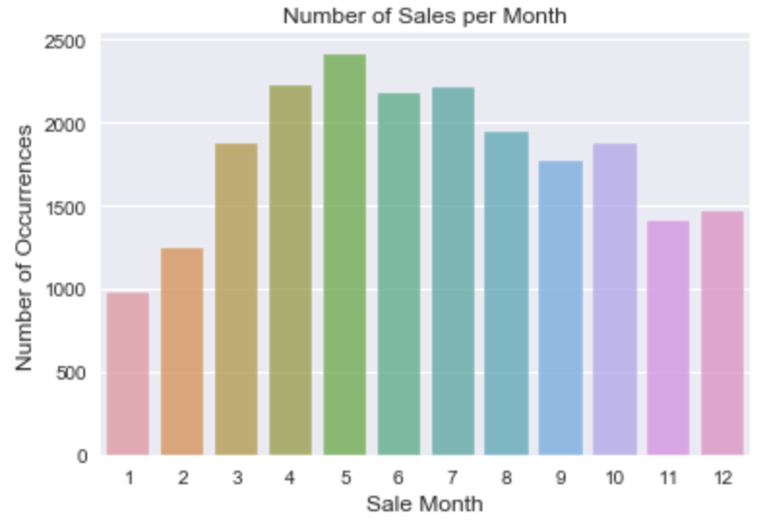
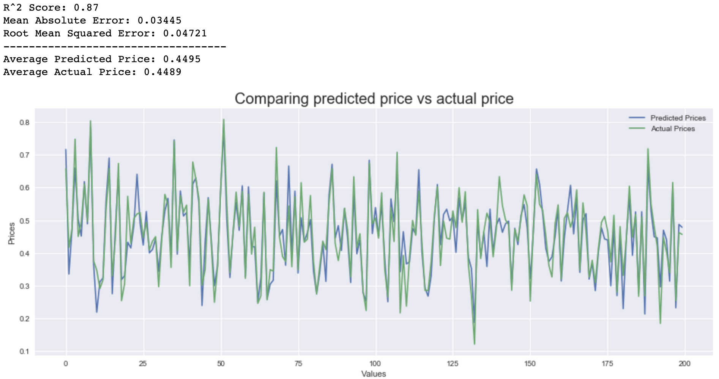
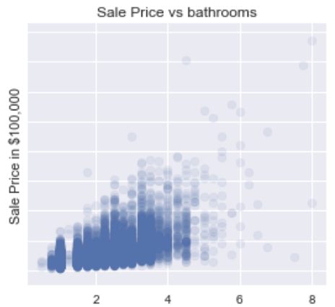
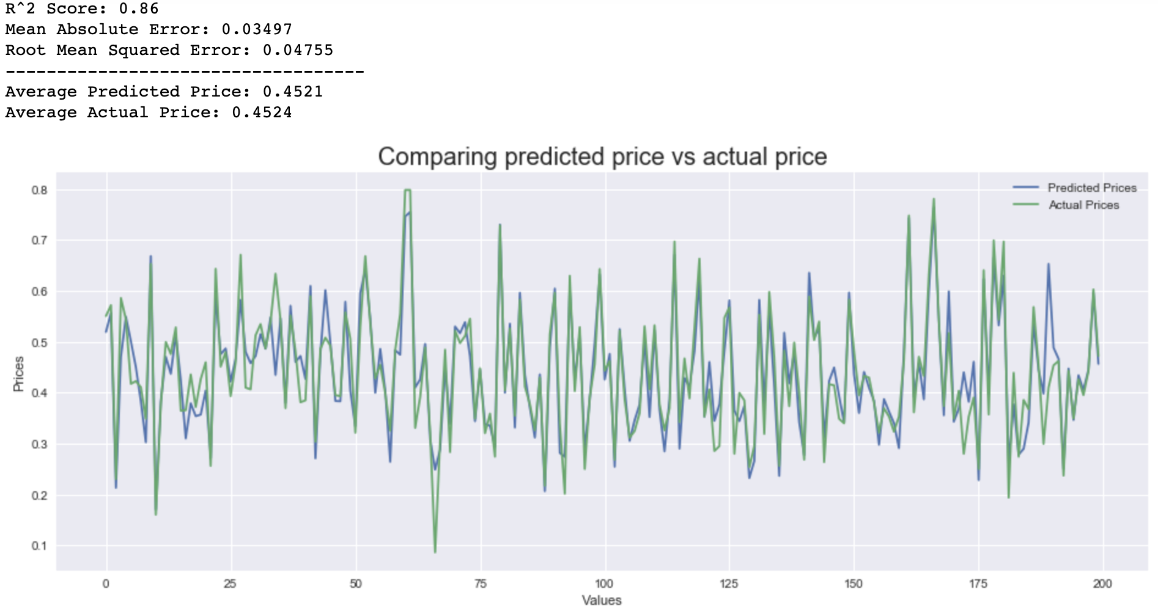
Interesting insights/additional recommendations:
There are increased sales during the late spring/early summer months
If looking for an additional feature in a home, prioritize the number of bathrooms
Upward trend in bathrooms vs. price
Notes:
After some data exploration, I noticed that house sales increase during the late spring/early summer months. This may be something to keep in mind.
Also, if you intend to prioritize an additional feature on top of the three, we mentioned earlier, it would be sane to include number of bathrooms.
There is a positive correlation between number of bathrooms and price of the home. Interestingly enough, bathrooms strike one as being more important than are bedrooms.

Slide 11
Future work and research:
Improve linear regression model
Import and concatenate other datasets
Simulate different scenarios
Search for any confounding variables
Notes:
Look for additional ways to improve the efficiency of our linear regression model
Import and concatenate other datasets that would complement the one we have
Simulate different scenarios when performing linear regression
Search for any confounding variables or hidden correlations we may not be aware of associated with zipcodes, and grades

Slide 12

Thank you

